Slide 1
What are the different physical, motor and sensory skills we develop?
This presentation will help staff to understand:
Different physical motor and sensory skills the people develop

Slide 2
Gross Motor Skills
Gross motor skills are larger movements which require whole body movement which we make with our arms, legs, feet, or our entire body.
The development of motor skills is from the centre out.
Motor skills rely on patterns of stability and mobility in the trunk, then the shoulders, elbows and wrists, and then the fingers.
Without central trunk control, we would not be able to control the movements of our limbs.

Slide 3
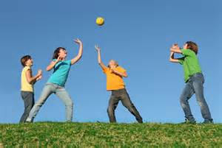
Gross Motor Skills
Gross motor skills involve the large (core stabilising) muscles of the body and help children move through space fluidly, navigate new layouts and participate in a range of different everyday physical activities such as:
Crawling
Walking
Running
Playing
Self care
Gross motor skills are different to fine motor skills which involve the just intricate movements of the hand.

Slide 4
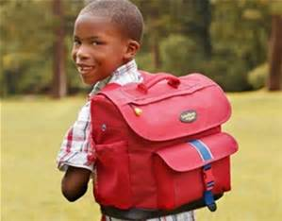
Gross and Fine Motor Skills
Gross motor skills also affect every day activities for children such as their ability to maintain a table top posture (upper body support).
This is necessary so that they can use and develop fine motor skills such as:
Writing and
The ability to sit upright so they can listen, learn and concentrate
Activities such as moving round the school and carrying their schoolbags are also affected

Slide 5
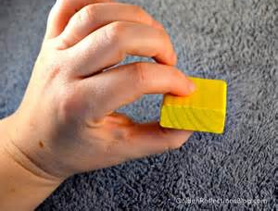
Hand and Fine Motor skills
Fine motor skills include the smaller muscle of the hands.
Fine motor skills are complex; a number of independent fine motor skills need to work together for a learner to appropriately manipulate different objects.
Hand skills include:
Reach – ability to move the arm to grasp/place objects
Grasp – whole hand hold of an object
Carry – moving and object from one place to another using the hands
Voluntary release – letting go of an object
In hand manipulation – moving objects within the hand
Bilateral hand use – using two hands together
Hand skills are dependent on posture, visual perception, tactile and proprioceptive feedback

Slide 6
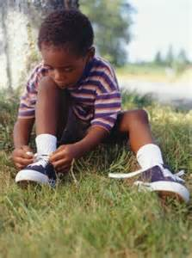
Hand and Fine Motor Skills
Hand skills development is part of the overall sequence of development beginning at birth and continues through expected developmental stages
Fine motor skills are extremely important. The hands are the tools most often used by all of us to accomplish work and play and to perform activities of daily living’ (Case Smith J 2005).
Children need them to write or draw with a pen or pencil, do up their shoes or buttons and open lunch boxes and doors.
The quality of children’s fine motor skills will affect how good they are at doing that task e.g. handwriting as well as how long that task will take them.

Slide 7
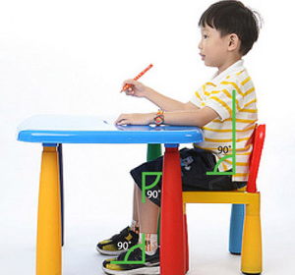
Posture
Posture is the ability to stabilise from the centre so children can move their head, eyes and limbs.
We need an adequate base of support whatever we are doing.
In sitting, we need a 90 – 90 – 90 in sitting position. (90 degree bend at ankle knee and hip - See image)
The base of support is the pelvis and feet which should be placed on the floor
In standing, our base of support is our feet, but the trunk still controls the stability
We have a dynamic base of support in walking using whole body in a stable way to enable mobility
If we have an inadequate base of support, we would not be able to adopt comfortable positioning to enable us to engage in tasks

Slide 8
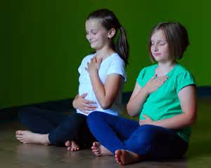
Posture
Posture affects the ability to attend to learning and also enables bodily functions such as breathing, circulation, swallowing, intake of nutrients and attention
It impacts emotional wellbeing. If we are unable to gain comfortable positioning, there is more likelihood of discomfort which will in turn impact emotional response, attention and engagement

Slide 9
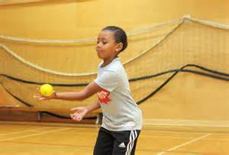
Coordination
Coordination involves the organization of the different elements of your body so they can work together effectively to complete an activity.
It includes the ability to control our bodies to carry out sequences of movement for given tasks
Pupils need good eye hand coordination, not just good fine or gross motor skills to write and catch balls.
To hop, a child needs the initial postural control but also the ability to balance and sequence (or coordinate) movements to move from one place to the next.

Slide 10
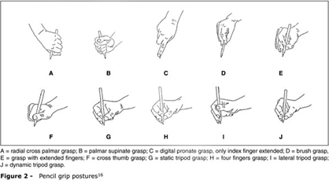
Writing
Writing is a skill which is greatly focussed on in academic environments.
Writing is a complex skill that involves a learner using many different skills all at once.
These included:
A number of fine motor skills
A number of gross motor skills
Postural stability
Eye/hand coordination
Visual discrimination
and many more
Pencil Grasps
Children are expected to be able to write very early within the educational system. Yet, many may not be ready.
A= radial cross palmar grasp B= palmar supinate grasp
C= digital pronate grasp, only index finger extended D= brush grasp
E= grasp with extended fingers F= cross thumb grasp
G= static tripod grasp H= four fingers grasp
I= lateral tripod grasp J= dynamic tripod grasp

Slide 11
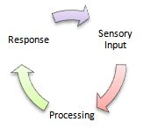
Sensory Processing skills
Sensory Processing or Sensory Integration includes being able to effectively register and interpret the sensory input a child gets from what’s around them and from their own body.
It is about how the brain receives, organises and responds to sensory input in order to behave in a meaningful and consistent manner.

Slide 12
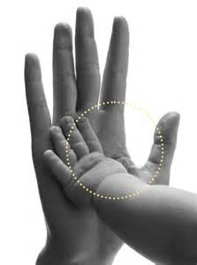
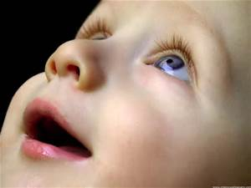
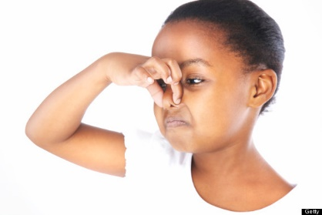
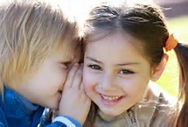
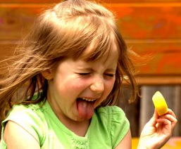
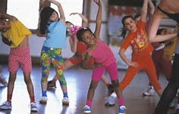
Sensory Processing Skills
This includes the ability to process from ALL the 7 senses :
Vision
Body Awareness (proprioceptive)
Touch
(protective and discriminative)
Smell
Hearing
Taste
Movement (vestibular)

Slide 13
Sensory Processing skills
A new-born baby has all their senses but does not know how to interpret or organise them so can’t get meaning from them.
As they become more familiar with different sensory input, they can gradually begin to understand, interpret and get meaning from their senses and get more adept at dealing with more and more sensory input over time.
In consequence, they can respond to the world more effectively and control their emotions better. This can be shown in their behaviour, attention, skills and ability to self regulate (be able to manage their emotional and cognitive responses).
A child will also be able to understand and manage their body's movement in relation to their surroundings and itself and this will allow them to develop their gross motor and social skills.

